Slide 1


Welcome you all
Process Management & Threads and Concurrency
DAY : 1
D.Sakthivel
Assistant Professor & Trainer,
KGiSL Micro College
KGiSL Campus, Coimbatore – 641 035.

Slide 2
Day 1
Process Management
Introduction
Process Memory
Process State
Process Control Block
CPU Scheduling algorithms
First Come First Serve
Shortest Job First
Priority Scheduling
Round Robin Scheduling
Inter Process Communication

Slide 3
Day 1
Threads and Concurrency
Threads
Multi-Threaded Process
Single-Thread Process
Process vs Threads
Thread Concurrency
Deadlock
Deadlock Conditions

Slide 4

Overview of Process Management
Process
The process is a program that's executing.
When a program is loaded into the memory, it becomes a process.
Each instance of the program is a different process.

Slide 5
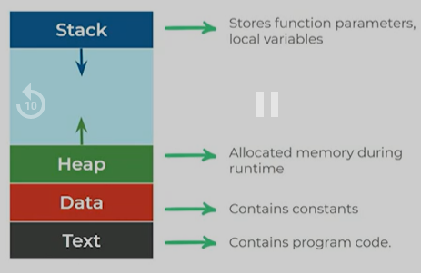
Process Memory - STACK

Slide 6
Process Memory - STACK
Each process has process memory.
Process Memory is divided as follows.
Stack: It stores temporary data like function parameters, returns addresses, and local variables. The stack grows and shrink.
Heap: It allocates memory, which may be processed during its run time.
Data: It contains constants.
Text: It includes the current activity, Contains Program Code.

Slide 7
Process Memory - STACK
Each process has process memory.
Process Memory is divided as follows.
Stack: It stores temporary data like function parameters, returns addresses, and local variables. The stack grows and shrink.
Heap: It allocates memory, which may be processed during its run time.
Data: It contains constants.
Text: It includes the current activity, Contains Program Code.

Slide 8
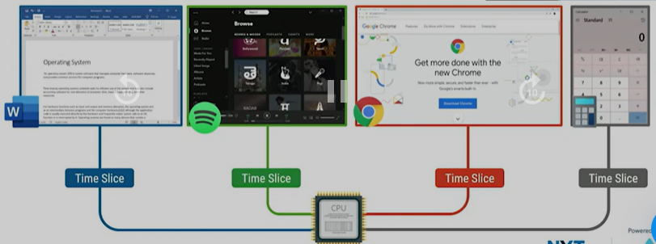
Process Management

Slide 9
Context Switching
Kernel switching from one process to another process is known as Context Switching.
Reason for Context Switching
Process with high priority arrives for execution
Running process requires I/O resources in the system and anymore..

Slide 10
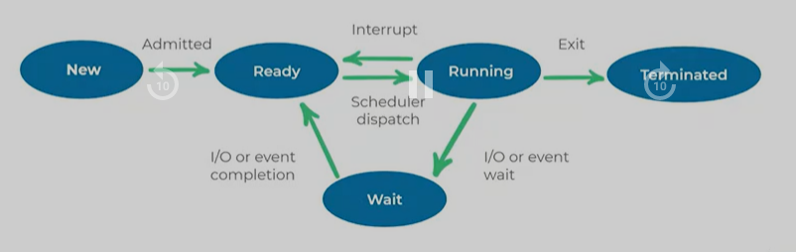
Process State

Slide 11
Process State
When a process executes, it passes through different states. These stages may differ in different operating systems.
New: The initial state when a process is first started/created.
Ready: The process is waiting to be assigned to a processor.
Running: The process is chosen by the CPU for execution and the instructions within the process are executed.
Waiting: Process wait for a resource, such as waiting for user input, or waiting for a file to become available.
Terminated: When a process finishes its execution, it comes in the termination state.

Slide 12
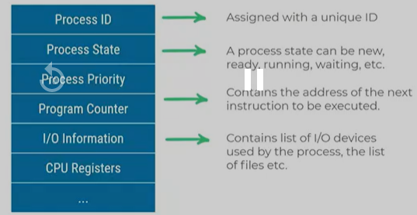
Process Control Block
A Process Control Block is a data structure maintained by the Operating System for every process.
Context of a process represented in the PCB. The PCB is identified by an integer process identifier (PID).
PCB is maintained by the OS for every Process
The PCB is identified by an integer process Identifier

Slide 13
CPU Scheduling
Process of determining which process will own CPU for execution while another process is on hold.
The aim of CPU scheduling is to make the system efficient, fast and fair.
Whenever the CPU becomes idle, the OS must select one of the processes in the ready queue to be executed.

Slide 14
CPU Scheduling
CPU Scheduling Algorithms
The selection process is carried out by the CPU scheduler using different algorithms they are
First Come First Serve (FCFS)
Shortest-Job-First (SJF) Scheduling
Priority Scheduling
Round Robin Scheduling and many more ..

Slide 15
Terminologies
Arrival Time: Time at which the process arrives in the ready queue.
Completion Time: Time at which process completes its execution.
Burst Time: The time required by a process for CPU execution.
Turnaround Time: The total amount of time spent by a process in the system.
Turnaround Time = Completion Time – Arrival Time
Waiting Time: Amount of time spent by a process in the ready queue.
Waiting Time = Turnaround Time – Burst Time

Slide 16
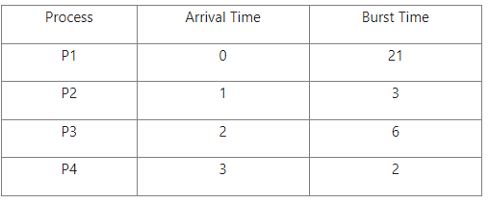

First Come First Serve
A process that requests the CPU first gets the CPU allocated first.
A process that arrived in the ready queue earlier will be executed earlier.
The process p1, p2, p3, and p4 are schedule with First Come First Serve are as follows.

Slide 17
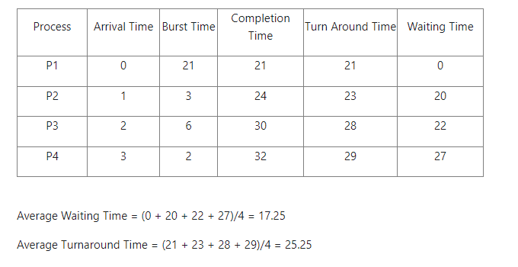
First Come First Serve
So, the Completion time, Turnaround time, Waiting time of the process(p1, p2, p3 & p4) are as follows.

Slide 18
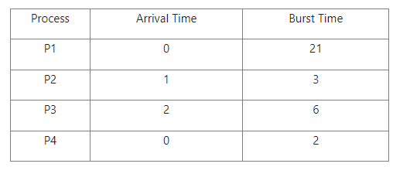
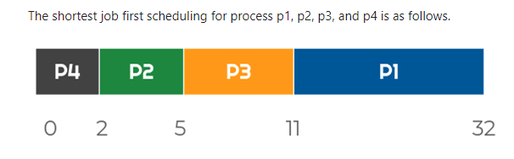
SHORTEST JOB FIRST
Shortest Job First(SJF) scheduling works on the process with the shortest burst time or duration first.

Slide 19
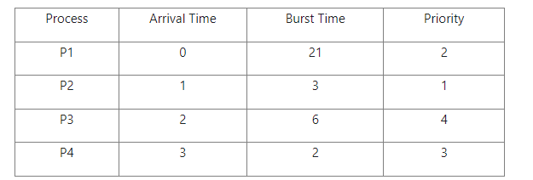
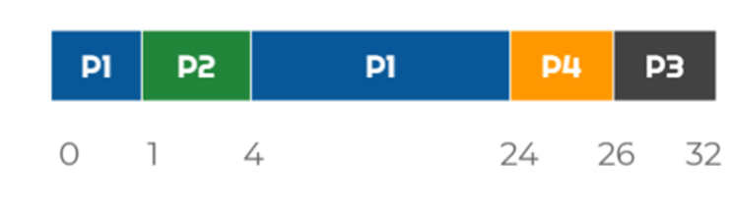
PRIORITY SCHEDULING
Priority Scheduling Algorithm works on the process with the higher priority. Processes with the same priority are executed in an FCFS manner.
The processes(p1, p2, p3, and p4) scheduled based on Priority Scheduling are as follows.

Slide 20
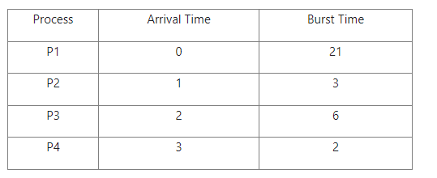
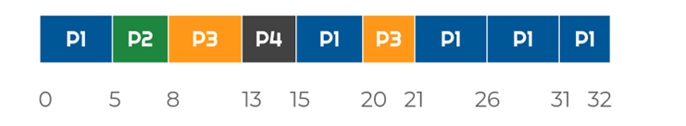
Round robin SCHEDULING
In Round Robin Scheduling a fixed time is allotted to each process called Time Slice for execution. Once a process is executed for the given time period then another process executes for the given time period.
Suppose the Time Slice is 5 units and the process p1, p2, p3, and p4 are scheduled in Round Robin Scheduling are as follows.

Slide 21
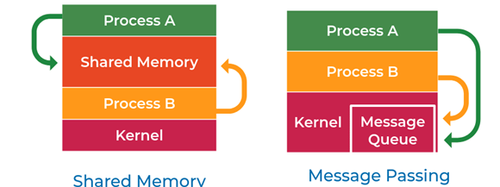
Inter - process Communication
Shared Memory
A particular region of memory is shared between the cooperating process.
Exchanging information by reading and writing data to this shared region.
Message passing
Communication takes place by exchanging messages directly between the cooperating process.

Slide 22
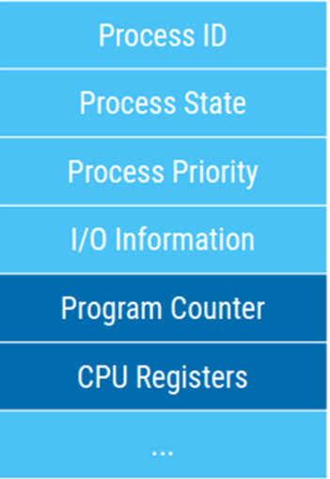
Threads and Concurrency
Process Execution State
Program Counter determines the next instruction to be executed.
Results in a stream of instructions which are often referred to as a thread of execution.

Slide 23
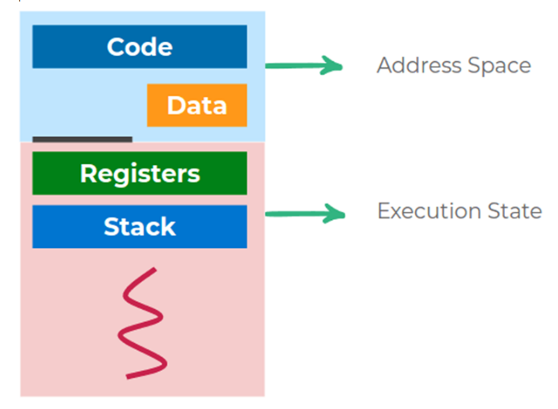
Threads and Concurrency
Threads
The sequential flow of control within a process is called as a thread.
Each thread has
A program counter
A register set
A stack space

Slide 24
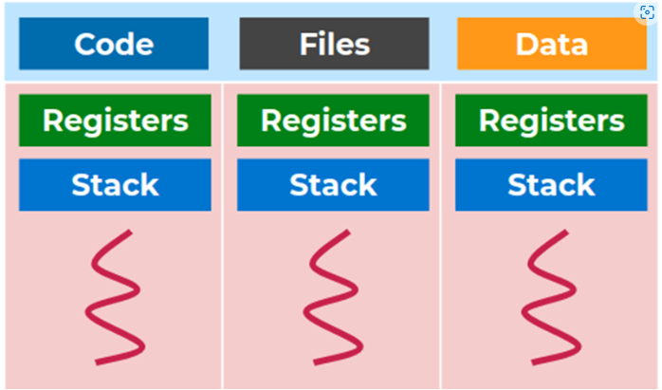
MULTI Thread Process
Multi-Threaded Process
A process can have multiple threads.
Each thread can run on a separate processor, thus utilizing multiple cores of the CPU

Slide 25
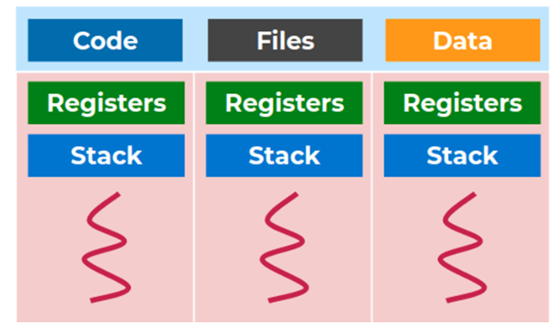
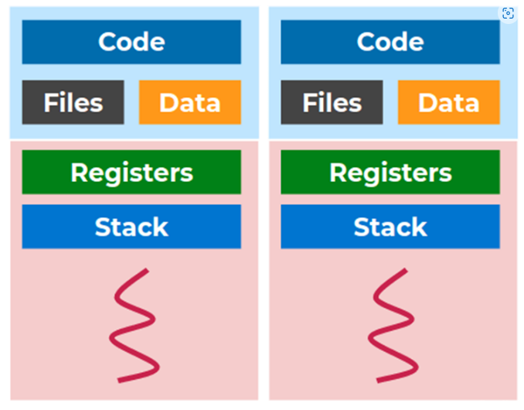
Multi Process Vs Threads
Multiple Single Threaded Process
Single Multi - Threaded Process

Slide 26
Process vs Threads
Threads are lightweight.
Less time to create and terminate.
Faster to context switch between threads.
Quicker communication between threads.

Slide 27
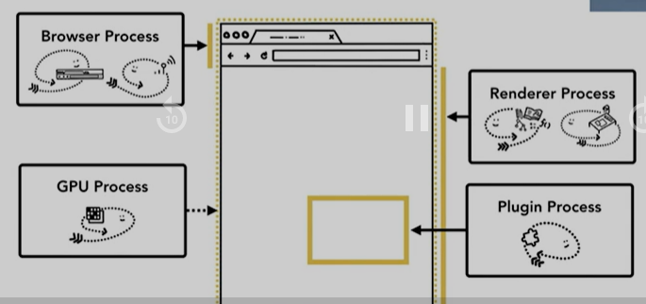
Google Chrome
Google Chrome
Core control part of the browser - browser process
Rendering the web page and interaction - render process
Plugins
Efficient running - GPU process

Slide 28
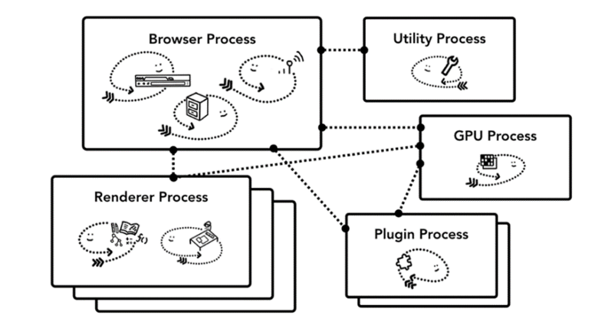
Mozilla Firefox
Four different processes. Multiple tabs run as threads within these processes.
Relatively less memory utilization compared to Chrome.
Advantages of Multi-Thread
Responsiveness
Resource Sharing
Economy
Utilization of multiprocessor architectures

Slide 29
Thread Concurrency
Thread Concurrency
Concurrency is the execution of the multiple instruction sequences at the same time.
Concurrency occurs when several process threads running in parallel.
Advantages
Responsive applications
Better resource utilization & performance.
Disadvantages
Multi-threaded programs are harder to develop and can have bugs that are difficult to debug.

Slide 30
Thread Concurrency
Thread Concurrency
Concurrency is the execution of the multiple instruction sequences at the same time.
Concurrency occurs when several process threads running in parallel.
Advantages
Responsive applications
Better resource utilization & performance.
Disadvantages
Multi-threaded programs are harder to develop and can have bugs that are difficult to debug.

Slide 31
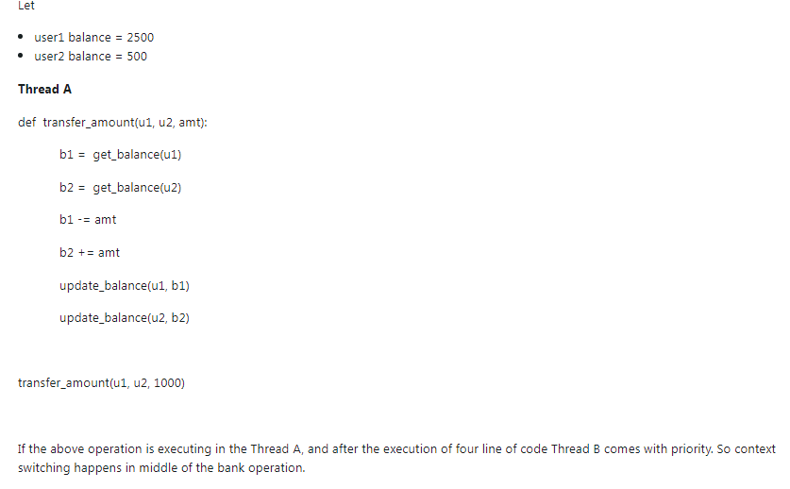
Concurrency

Slide 32
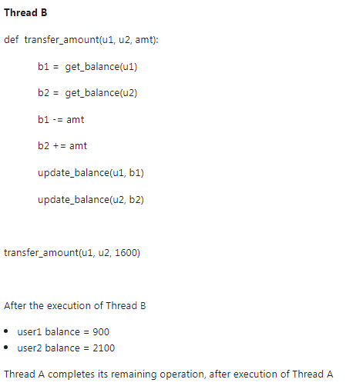
Concurrency

Slide 33
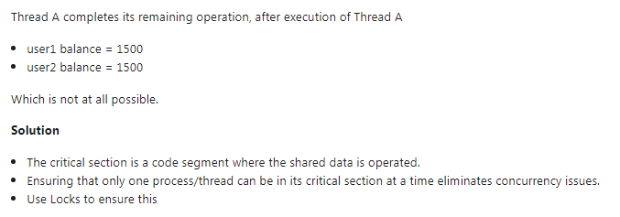
Concurrency

Slide 34
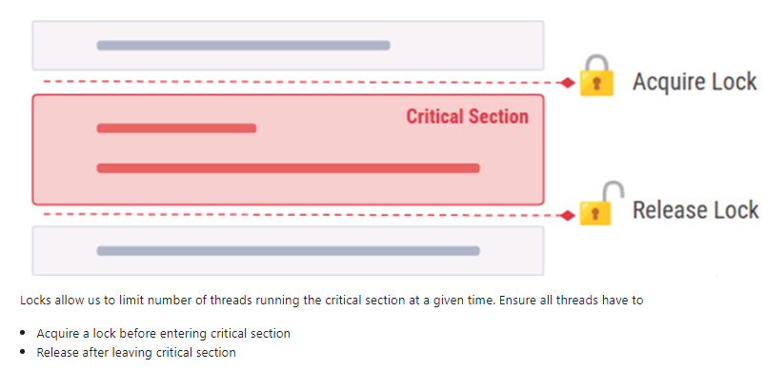
Concurrency

Slide 35
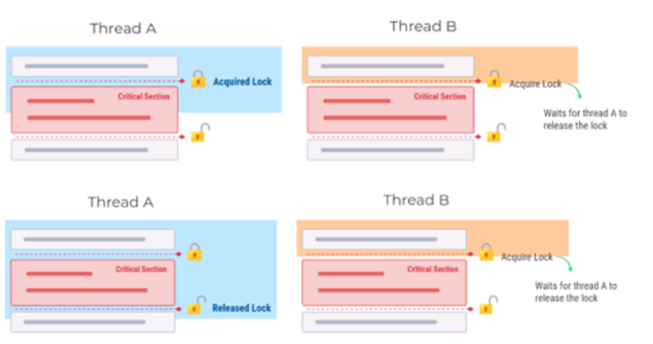
Concurrency

Slide 36
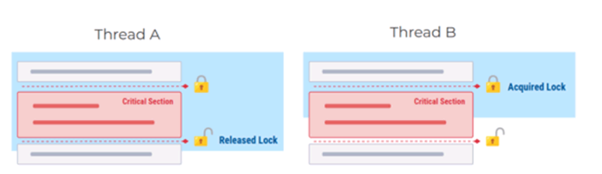
Concurrency

Slide 37
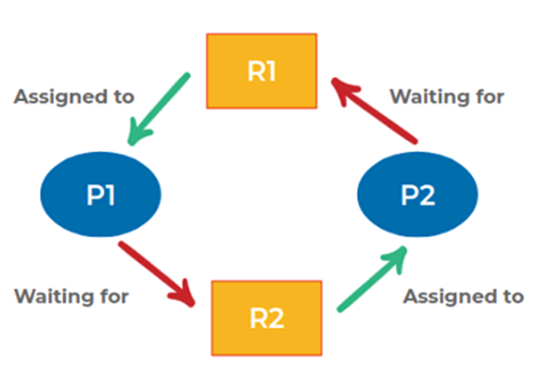
Deadlock­
A situation where a set of processes are blocked because each process is holding a resource and waiting for another resource acquired by some other process.

Slide 38
Deadlock Conditions
Conditions for Deadlock:
Mutual exclusion: The resource can be held by one process at a time
Hold and wait: A process can hold multiple resources and still request more resources from other processes which are holding them.
No preemption: A resource cannot be acquired from a process by force. A process can only release a resource voluntarily.
Circular wait: If every process is waiting for each other to release the resource and no one is releasing their own resource. This is called a circular wait.
Dealing with Deadlock
Avoid deadlocks by ensuring at least one of the above conditions is not met.
Let deadlocks happen. Detect and break the deadlocks

Slide 39



Thank You

